Slide 1
SUSTAINABILITY REPORT 2022

Slide 2
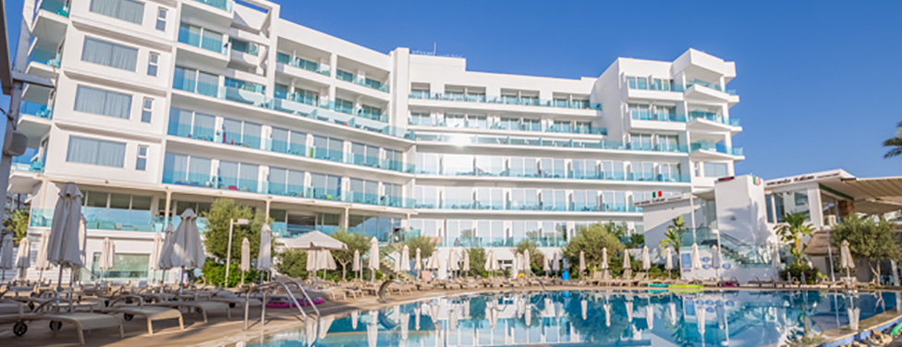
Vrissaki Beach Resort recognizes its responsibility to become environmentally and financially sustainable, and is committed to engage in practices with the support of the management and team associates to achieve a continual improvement of our performance in vital areas of the hotel.
We care about the environment
http://www.vrissakibeachhotel.com
Sustainability Report 2022

Slide 3
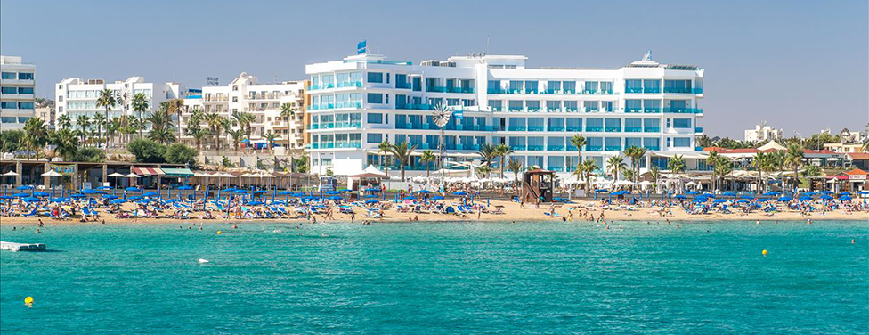
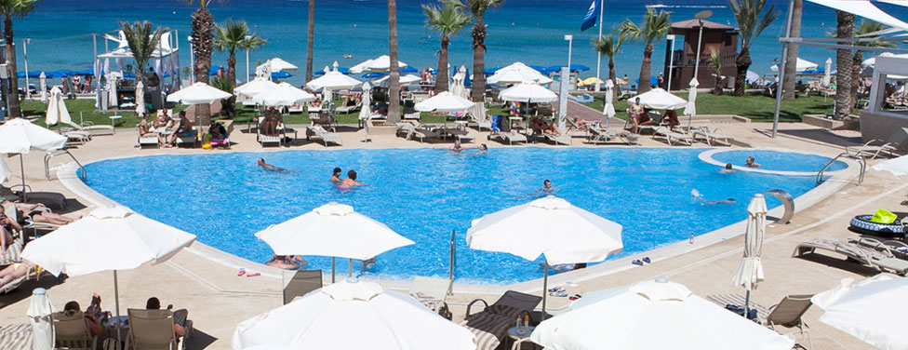
Vrissaki Beach Resort (Hotel Profile)
The Vrissaki Beach Hotel is rightfully proud to be among the finest 5 star hotels in the Protaras holiday resort on the south eastern coast of Cyprus.
Situated in the heart of Protaras, the Vrissaki Beach Hotel is positioned right on the largest beach of Protaras with golden sand and crystal clear waters, the famous Fig Tree Bay.
We care about the environment
http://www.vrissakibeachhotel.com
Sustainability Report 2022

Slide 4
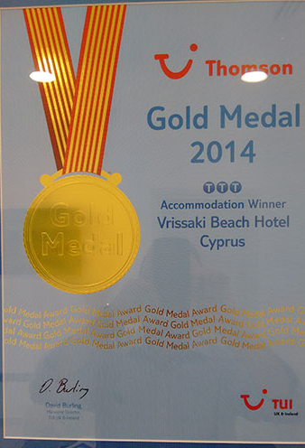
Our Awards
We care about the environment
http://www.vrissakibeachhotel.com
Sustainability Report 2022

Slide 5
ENVIRONMENT
Whilst we strive to enhance the quality of our guest’s stay and ensure they take home memorable experiences, we do all that with respect to the local environment and we manage our impacts for the benefit of the local community in which we operate.
We care about the environment
http://www.vrissakibeachhotel.com
Sustainability Report 2022

Slide 6
SAVING ENERGY
We are constantly working to upgrade our equipment with more suitable devices that incorporate energy saving features to reduce energy consumption.
We care about the environment
http://www.vrissakibeachhotel.com
Sustainability Report 2022

Slide 7
Electricity (kWh per guest night)
Target
14.04kWh
13.79kWh
2020
2021
2022
We care about the environment
http://www.vrissakibeachhotel.com
Sustainability Report 2022

Slide 8
Gas Consumption(kWh per guest night)
Target
kWh
2.85
kWh
2.80 kWh
2020
2021
2022
We care about the environment
http://www.vrissakibeachhotel.com
Sustainability Report 2022

Slide 9
Total Energy Consumption(kWh per guest night)
Target
kWh
15.89
kWh
15.57kWh
2020
2021
2022
We care about the environment
http://www.vrissakibeachhotel.com
Sustainability Report 2022

Slide 10
SAVING WATER
We believe in rational use of water that strives to reduce consumption and minimize waste
We care about the environment
http://www.vrissakibeachhotel.com
Sustainability Report 2022

Slide 11
Water (m³ per guest night)
Target
2020
2021
0.22
2022
0.21
We care about the environment
http://www.vrissakibeachhotel.com
Sustainability Report 2022

Slide 12
WASTE MANAGEMENT
Any liquid and solid waste resulting from the Hotel’s operations are separated and handled by approved licensed suppliers. All solid waste is separated and collected by licensed recyclers.
We care about the environment
http://www.vrissakibeachhotel.com
Sustainability Report 2022

Slide 13
Recycled Waste
Batteries Used Oil Plastic Paper Glass
2022 : kg
2021 : 15 kg
2020 : 0 kg
2022 : ltr
2021 : 1719 ltr
2020 : 0 ltr
2022 : kg
2021 : 2486 kg
2020 : 0 kg
2022 : kg
2021 : 1200 kg
2020 :0kg
2022 : kg
2021 : 4000 kg
2020 : 0 kg
We care about the environment
http://www.vrissakibeachhotel.com
Sustainability Report 2022

Slide 14
Sustainability Activities
Energy consumption has been reduced by using Renewable Energy (solar) and heat/recovery systems for heating and cooling.
Energy saving systems has been installed photovoltaic and solar panels.
All the old external big lights and lamps in the complex have been replaced with led light technology.
Heat /Motion detectors have been placed where feasible in public areas.
Eye detection water fountains have been placed in all public toilets.
Recycled water from the Municipality is used for watering the gardens.
We care about the environment
http://www.vrissakibeachhotel.com
Sustainability Report 2022

Slide 15
Sustainability Activities
The percentage of goods and services bought locally is 40% of the total purchases items.
Great effort has been made also regarding our kitchen purchasing policy commitment and finally all our fresh produce purchases from local suppliers have exceeded 60% of the hotel purchases in fresh products.
Every effort is made to buy bulk quantities of chemicals (cleaning purposes/maintenance) and to return the plastic containers to the suppliers.
Any liquid and solid waste resulting from the Hotel’s operations are separated and handled by approved licensed suppliers and recyclers.
We care about the environment
http://www.vrissakibeachhotel.com
Sustainability Report 2022

Slide 16
SOCIAL RESPONSIBILITY
The Hotel contributes in many social and community activities not only with donations but with the organization of in house social events almost on a yearly basis.
The Hotel also supports almost all local activities which promotes our culture, customs and traditions.
We care about the environment
http://www.vrissakibeachhotel.com
Sustainability Report 2022

Slide 17
SOCIAL RESPONSIBILITY
Donation to Pancyprian Adoptions Organization
Donation to Red Cross
Donation for citizens medical treatments
Donation to Technical School of Paralimni
Donation to Pancyprian Farmers Union
We care about the environment
http://www.vrissakibeachhotel.com
Sustainability Report 2022

Slide 18
CUSTOMER SATISFACTION
Our guests continue to trust Vrissaki beach hotel for their holidays and the percentage of repeaters is 30%, which shows clearly their satisfaction.
We care about the environment
http://www.vrissakibeachhotel.com
Sustainability Report 2022

Slide 19
HUMAN RESOURCES
At Vrissaki Beach Hotel we
strive to provide a safe workplace where the human rights are respected in accordance with the collective agreements with the unions and the applicable legislation.
We care about the environment
http://www.vrissakibeachhotel.com
Sustainability Report 2022

Slide 20
We are an equal opportunity employer and we support the protection of human rights, particularly those of our employees, the parties we do business with and the community where we operate.
All new employees are informed before they start work about the terms and conditions of their employment, including pay and welfare arrangements.
Employees | 2020 | 2021 | 2022
Male Employees |  | 50 | 32
Female Employees |  | 56 | 68
Local Staff |  | 95% | 60%
Other nationalities |  | 6% | 40%
We care about the environment
http://www.vrissakibeachhotel.com
Sustainability Report 2022

Slide 21
The Vrissaki Beach Hotel has devoted time and money to protect and safeguard human rights for those employed in the Hotel. Through the years the hotel has undertaken numerous seminars and other training programs both in management and lower level with the target of creating professional employees, working in a respectable environment, where human rights are recognised
At the Vrissaki Beach Hotel we give the best possible opportunity for staff to exchange their knowledge and to prove their talents. In this way we upgrade the quality and the standard of our employees as well as our establishments. We try to keep discrimination at its lowest level and in the meantime we give employment opportunities to locals as means of support to the community where we belong.
We care about the environment
http://www.vrissakibeachhotel.com
Sustainability Report 2022

Slide 22
SUSTAINABILITY WARRANTY
We obtained certification for the TRAVELIFE system, ensuring the sustainable management of our hotel and the implementation of our commitments
Our hotel achieved excellence in demonstrating advanced sustainability whilst also encouraging others to participate in seeking such continuing enhancement and dynamically communicating progress.
We care about the environment
http://www.vrissakibeachhotel.com
Sustainability Report 2022

Slide 23
THANK YOU FOR HELPING US ACHIEVE OUR GOALS! 2022

